Slide 1
EEE 554: Probability and Stochastic Processes
This file contains most of the slides we will be going through in Spring 2023. For all
the details of what we went through, please check out the recorded lectures.

Slide 2
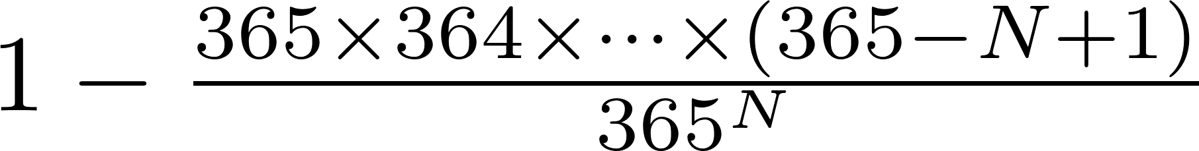
Example: Birthday Problem
Birthday problem: Given N people in a room, what is the probability that 2 or more people will have the same birthday?
1 – “Probability that all N people have different bdays”

Slide 3
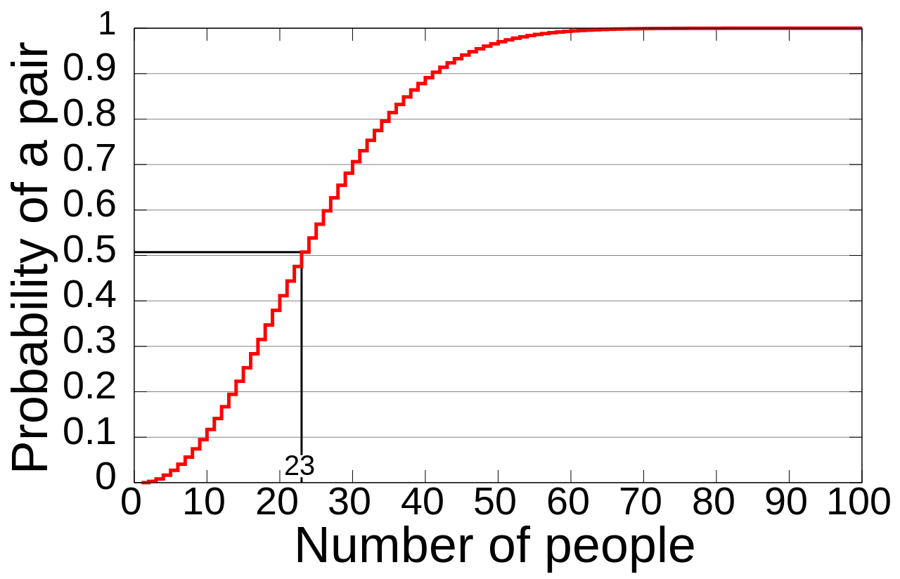
Example: Birthday Problem
http://en.wikipedia.org/wiki/Birthday_problem

Slide 4

Example: Monty Hall Problem
Game show setting; 3 doors: 2 Goats, 1 Car
You chose one door. Host opens one of the doors that you didn’t pick and has a goat.
You have the option to stick with your choice or switch
What should you do??
http://en.wikipedia.org/wiki/Monty_Hall_problem

Slide 5
Example: Monty Hall Problem
Assume you are committed to switching.
If you had selected a C initially, then switching will lead to a G (why?)
If you had selected a G initially, the switching will lead to a C.
Since selecting a G initially is more likely (2/3 prob), then switching is the best policy
Conclusion: Switching is twice more likely to win you a car than sticking with your original choice!
The extra info that the host provides is useful!

Slide 6
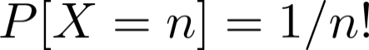
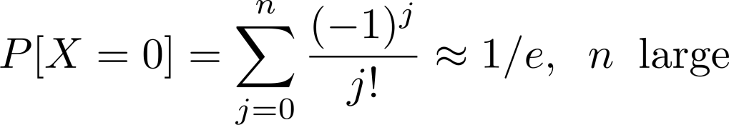
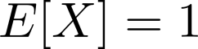
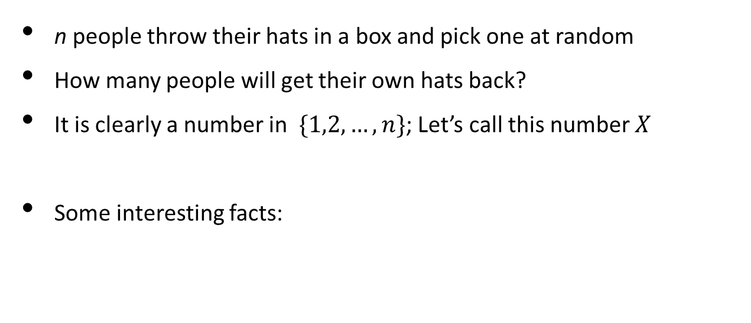
Example: The Hat Problem
n people throw their hats in a box and pick one at random
How many people will get their own hats back?
It is clearly a number in $\{1,2, …, n\}$; Let’s call this number $X$
Some interesting facts:

Slide 7
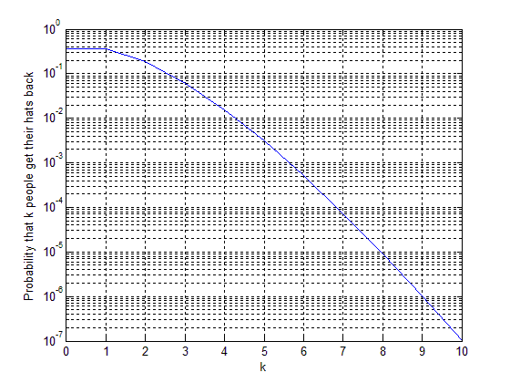
Example: The Hat Problem

Slide 8
Review of Set Theory
Probability theory is grounded in set theory
Union
Intersection
Compliment
De Morgan’s Law

Slide 9
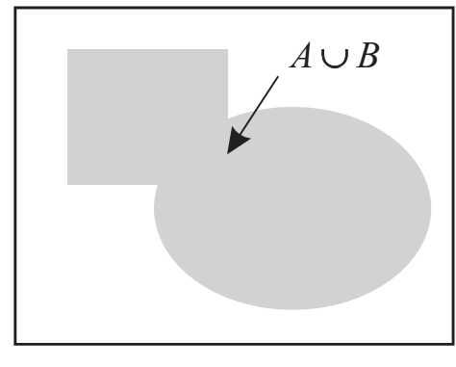
Set Union

Slide 10
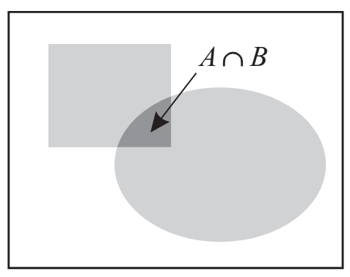
Set Intersection

Slide 11
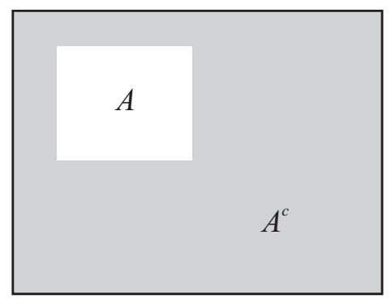
Set Compliment

Slide 12
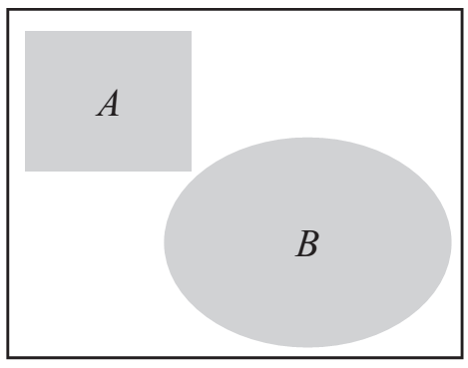
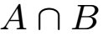

Mutually Exclusive (Disjoint)

Slide 13
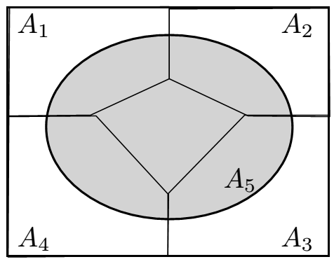
Collectively Exhaustive

Slide 14
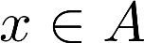
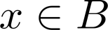
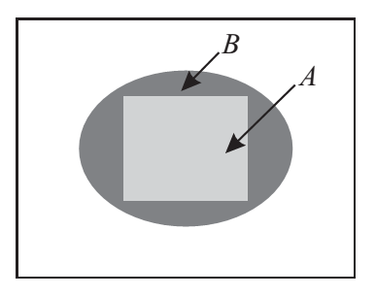
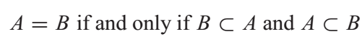
Other Basic Definitions
means if then

Slide 15
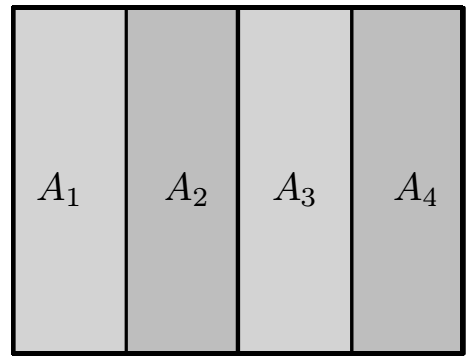
Partition
Both mutually exclusive AND collectively exhaustive

Slide 16
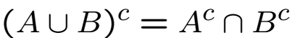
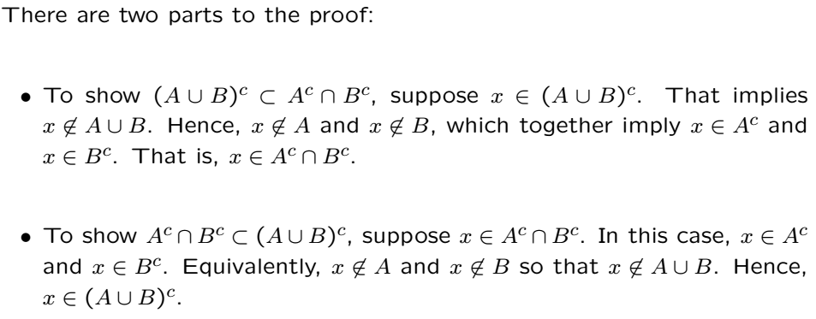
De Morgan’s Law

Slide 17
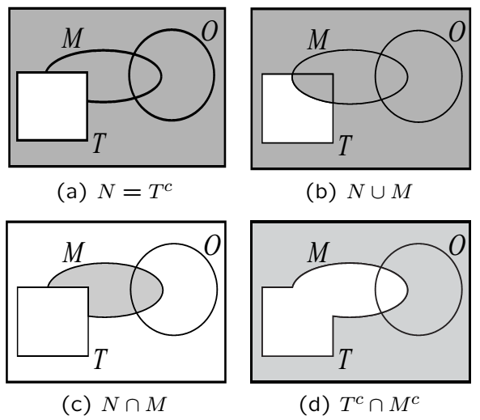
Example

Slide 18
Experiment
A repeatable procedure that produces potentially different outcomes at every trial
Set of all outcomes is the sample space
Events are sets of outcomes
Events are subsets of the sample space
Probabilities will be assigned to events

Slide 19

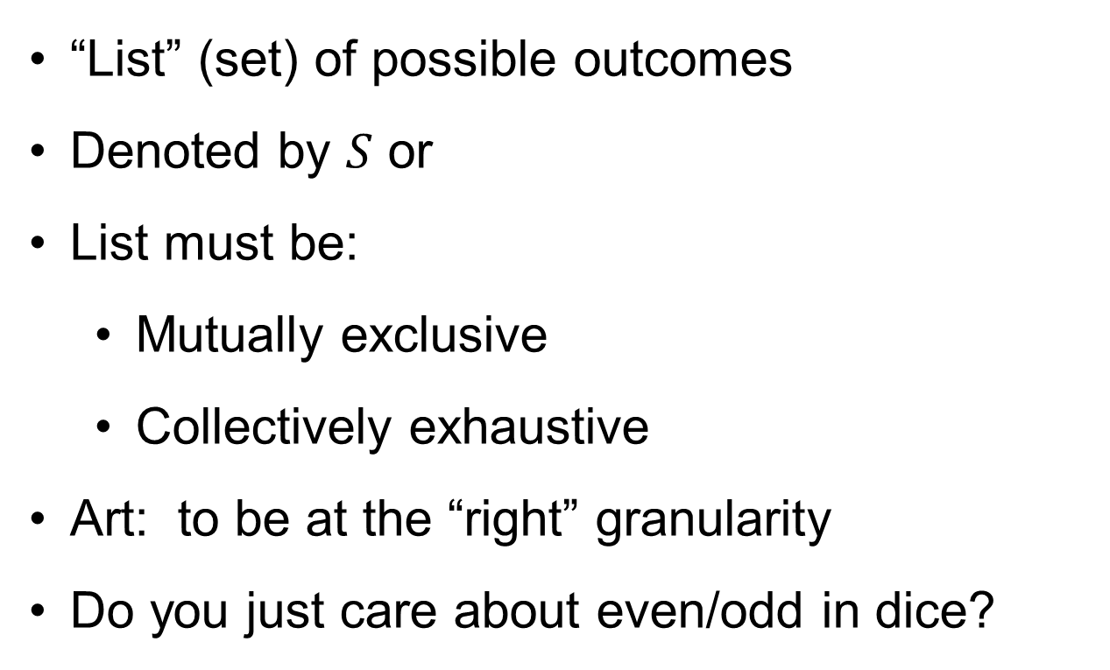
More on Sample Space
“List” (set) of possible outcomes
Denoted by $S$ or
List must be:
Mutually exclusive
Collectively exhaustive
Art: to be at the “right” granularity
Do you just care about even/odd in dice?

Slide 20
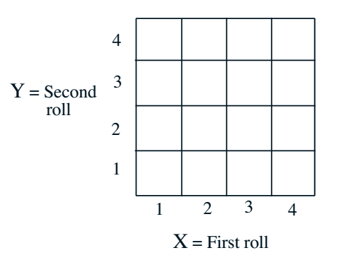
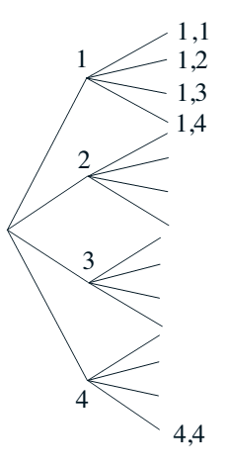
Sample Space: Discrete Example
Two rolls of a tetrahedral die
Sample space vs. sequential description

Slide 21
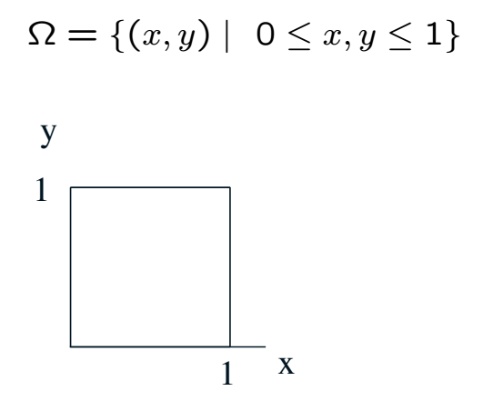
Sample Space: Continuous Example

Slide 22
Probability Space
Probability space consists of
Sample space
A collection of subsets of sample space called events
Probability assignments to each event
Events are subsets of sample space
Collection of events satisfy certain requrements
E.g. union of two events is an event; same with intersection
There are other technical requirements
How probabilities are assigned to events is subject to
rules (axioms)

Slide 23
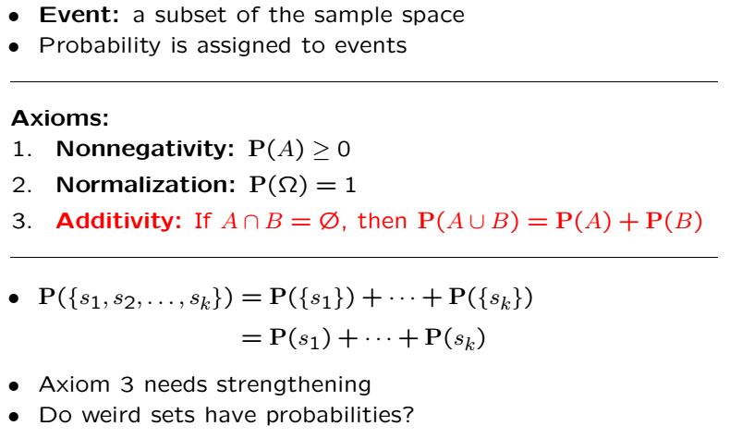
Axioms of Probability

Slide 24
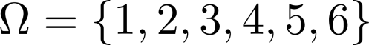
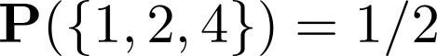
Example
Experiment: single dice roll
Outcomes are just 1,2,3,4,5,6.
Events are the set of all subsets
Closed under unions and intersections
There are 64 events
The probability of an event = (# of elements in the event) x 1/6
E.g.,

Slide 25
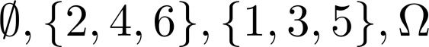
Alternate Example
Experiment: Single dice roll (same as before)
There are only 4 events: (different than before)
Closed under unions and intersections
Tells if outcome is even or odd
The probability of an event = (# of elements in the event) x 1/6

Slide 26
Discrete Example Cont’
Recall two rolls of a tetrahedral die
Events are collections of boxes
Probabilities of events = # of boxes / 16

Slide 27
Continuous Example Cont’
Events are regions in the box
Probabilities of events = Area of region

Slide 28
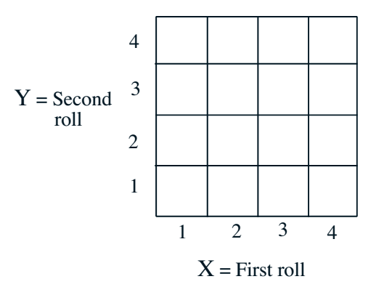
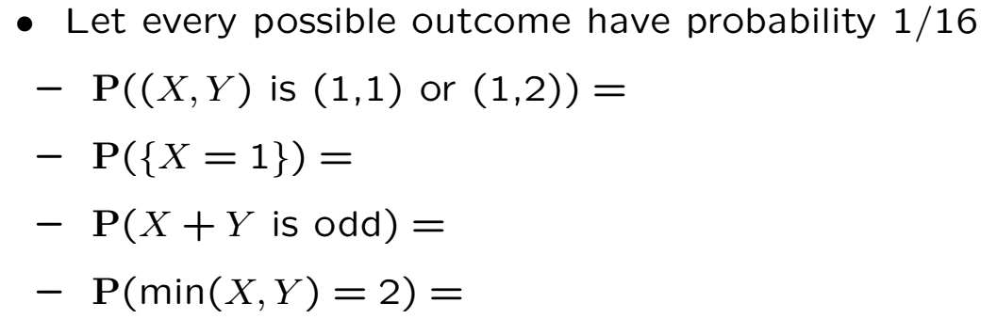
Finite Sample Space Example

Slide 29
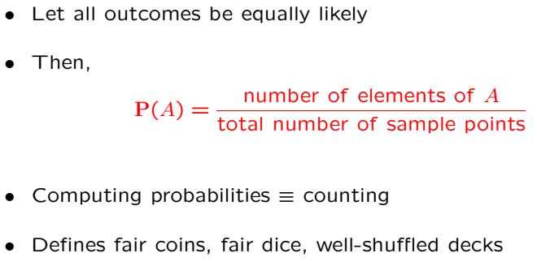
Discrete Uniform Law

Slide 30
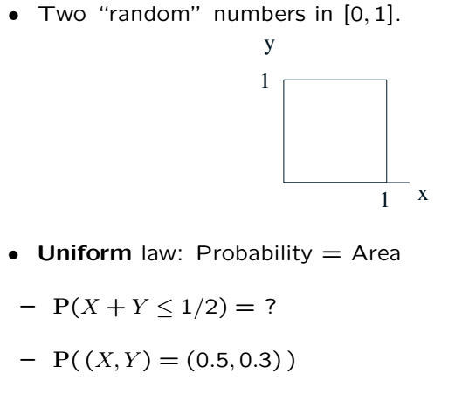
Continuous Uniform Law

Slide 31
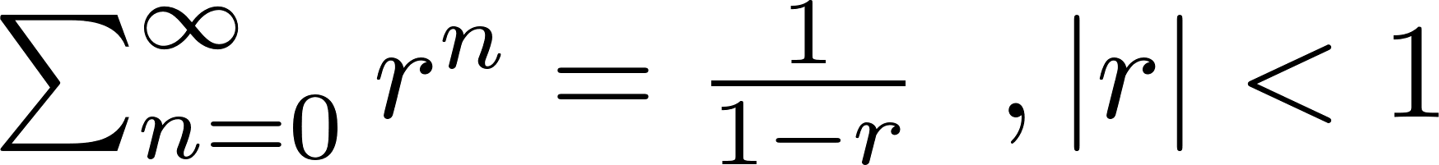
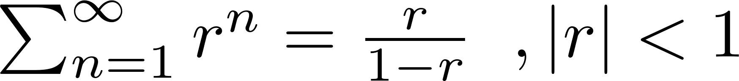
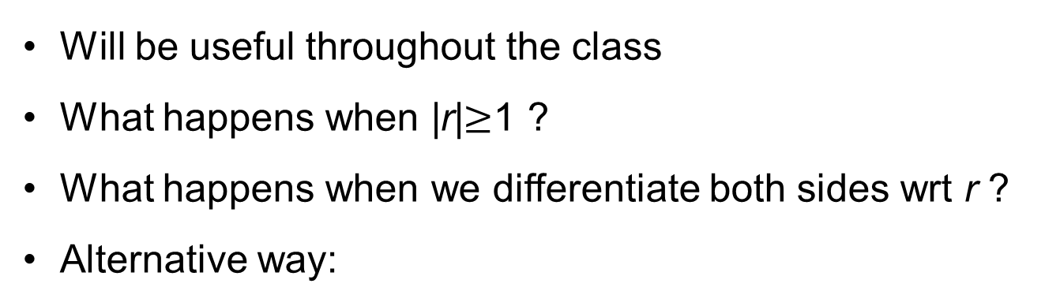
Geometric Sum Formula
Will be useful throughout the class
What happens when |r|$≥$1 ?
What happens when we differentiate both sides wrt r ?
Alternative way:

Slide 32
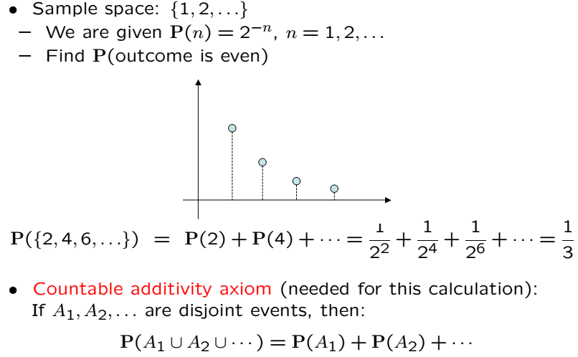
Countable Infinity

Slide 33
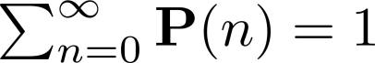
Countable Infinity Cont’
Can verify using the geometric sum formula (r=1/2)
Even outcome probability can be verified using same formula (r=1/4)

Slide 34
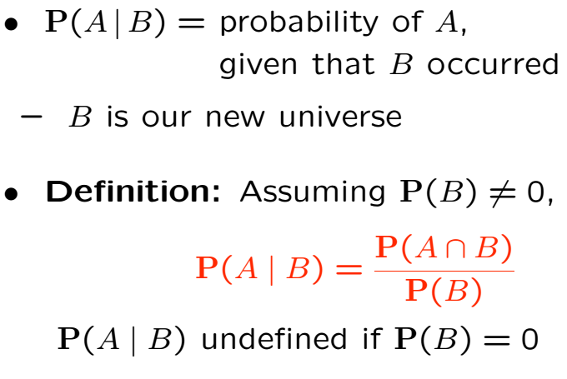
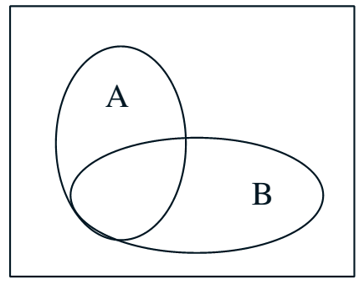
Conditional Probability

Slide 35
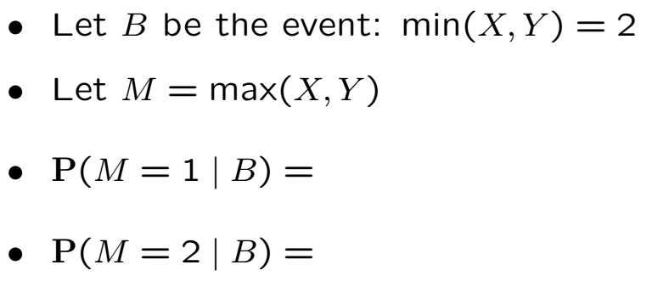
Die Roll Example

Slide 36
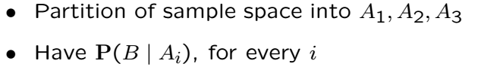
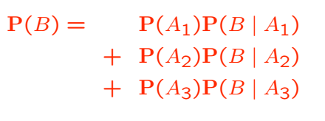
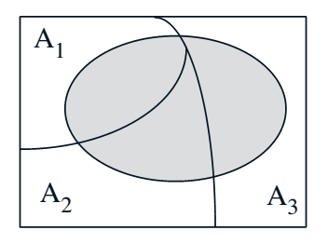
Total Probability Theorem

Slide 37
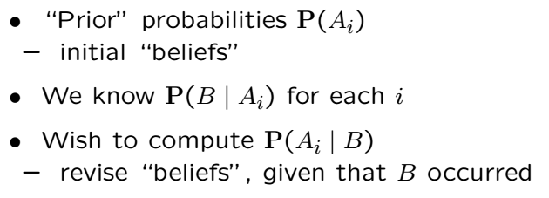
Bayes’ Rule
Systematic approach for incorporating new evidence
Thomas Bayes (1701-1761)

Slide 38
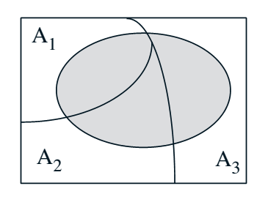
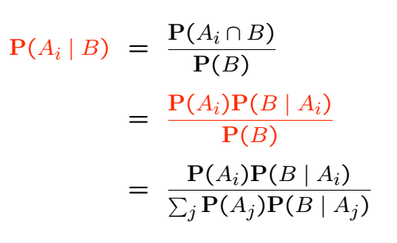
Bayes’ Rule Cont’

Slide 39
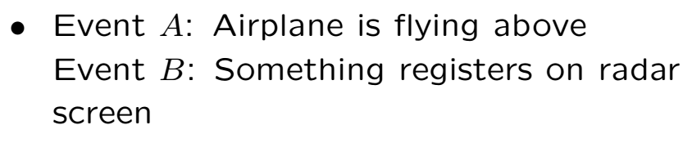
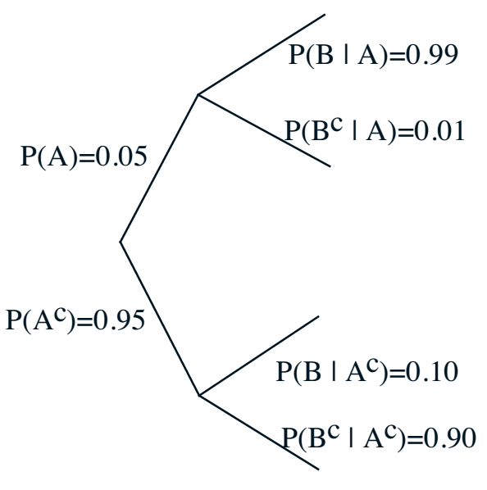
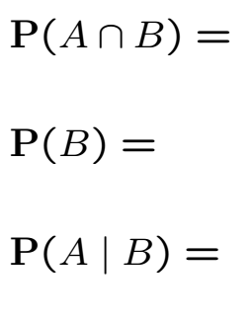
Models Based on Cond. Prob.

Slide 40



Sequence of Coin Tosses

Slide 41

Review

Slide 42

Independence

Slide 43

Conditioning May Ruin Independence

Slide 44


Conditioning and Independence
In contrast to prev. slide, removing conditioning may ruin independence
HH
HT
TH
TT
HH
HT
TH
Given selected coin, flips assumed indep.
TT

Slide 45
Conditioning and Independence Cont’
Removing conditioning may ruin independence
HH
HT
Recall given coin, flips are independent
If we don’t know which coin, are flips indep?
No! Because, previous trials have info about
which coin is selected.
TH
TT
HH
HT
TH
TT

Slide 46

Independence of a Collection of Events

Slide 47



Pairwise Independence

Slide 48

Counting!

Slide 49

Discrete Uniform Law

Slide 50



Basics

Slide 51

Example
0.0154
Don’t bet your money on it!

Slide 52


Combinations

Slide 53


Sum of Combinations
Proof: Counting bit strings of length n
kth term of the sum = # of length n bit strings with k ones
Both sides equal to total # of length n bit strings

Slide 54
Examples
How many binary sequences of length 10 are there?
How many 4-letter words can letters A-Z produce?

Slide 55


Splitting Deck into 4; one Ace Each
= 10.5%

Slide 56


Binomial Probabilities

Slide 57

Example

Slide 58
Example (Repetition Code)
To communicate 1 we send 111
To communicate 0 we send 000
We receive 3 (possibly toggled) bits
Bits toggle with probability q independently
Receiver does majority combining
What is the probability that receiver is fooled?

Slide 59


Random Variables

Slide 60


Probability Mass Function

Slide 61



Example

Slide 62



Bernoulli PMF
Bernoulli(p) RV takes on values 0 or 1
Same RV regardless of experiments producing
{0,1}
{H,T}
{Accept,Reject}

Slide 63

Binomial PMF
n indep. coin flips, p is prob. of success; how many successes?
Binomial (n,p) RV takes on values {0,1,…,n}
Can be viewed as a sum of n independent Bernoulli RVs

Slide 64


Binomial PMF Cont’

Slide 65

Recall Geometric PMF

Slide 66





Pascal PMF
Let L be the number of trials until k rejects
“reject” same as “heads”
p is probability of reject in each trial
Generalization of geometric PMF

Slide 67



Discrete Uniform RV
Equiprobable on consecutive integers k, k+1, …,l
Roll a fair die and observe the number of points

Slide 68



Poisson PMF
Used to model number of random arrivals
Example: Calls arrive randomly at 0.25 calls/sec
The PMF of number of calls in a 20 sec. interval?

Slide 69

Expectation
AKA “mean” of the RV or the distribution
Interpretations
Center of gravity of the PMF
Average in large number of repetitions of the experiment

Slide 70


Example: Uniform PMF

Slide 71




Example: Geometric PMF
Pulling the p out of the sum and using math identity
Math identity can be derived by differentiating the geometric sum formula

Slide 72




Example: Poisson PMF
Last sum is 1 because

Slide 73


Properties of Expectations

Slide 74



Other Examples without Proofs
Binomial (n,p)
Pascal (k,p)
Uniform (k,l)

Slide 75


Variance
Measure of “spread” of the PMF

Slide 76





Variance Examples
Consider the effect of parameters on variance
Random Variable | Variance
Bernoulli
Geometric
Binomial
Pascal
Poisson
Discrete Uniform
Proofs require summation tricks (see textbook)

Slide 77


Review of Mean and Variance

Slide 78



Review Cont’

Slide 79



Random Speed
Either riding a donkey (1 mile/hr)
OR a Ferrari (200 miles/hr)

Slide 80

Average Speed vs Average Time
Moral: Mean of the product not always the product of the means
Mean of the inverse not always the inverse of the means

Slide 81



Conditioning PMF on Events

Slide 82



Total Expectation Theorem

Slide 83




Example
is geometrically distributed
Compare with earlier derivation which required summation trick

Slide 84

Continuous RVs
The RV can take on a continuum of values
Its probability distribution is captured by a PDF

Slide 85

PDFs
Probability density function
Nonnegative and integrates to unity
Integrate over a set to find probability of set
If continuous, probability that the RV is any fixed value is zero

Slide 86

Means and Variances
Replace sums with integrals:

Slide 87

Example

Slide 88




Cumulative Distribution Function
CDFs are defined for any RV (continuous or discrete)
For continuous case
For discrete case

Slide 89

CDF Properties
It is the probability of something, so between 0 and 1
Monotone non-decreasing function
$F_{X}\left(−∞\right)=0; F_{X}\left(∞\right)=1$
Defined both for continuous and discrete RVs

Slide 90


Example

Slide 91




Example
Consider a geometric RV Y with p=1/4
CDF of Y ?
Recall
Here n is an integer but CDF is piecewise constant

Slide 92



Example
Consider a RV with CDF

Slide 93




Example
Consider a RV with CDF below; find PDF

Slide 94


Example
Consider a RV with PDF below

Slide 95

Solution

Slide 96

Solution Cont’

Slide 97


Example

Slide 98



Solution

Slide 99


Mixed Distributions
Dirac’s delta function shows that

Slide 100


Recalling Dirac’s Delta

Slide 101

Mixed Distributions Cont’

Slide 102

Example of Mixed Distributions

Slide 103


Worked Example

Slide 104

Solution

Slide 105

Continuous vs Discrete vs Mixed

Slide 106



Uniform Distribution

Slide 107



Exponential Distribution

Slide 108




Gaussian (Normal) Distribution

Slide 109


Gaussian (Normal) Distribution

Slide 110

Gaussian (Normal) Distribution

Slide 111


Calculating Normal Probabilities

Slide 112

Calculating Normal Probabilities
Tables exist
Can be constructed using numerical methods
No, you don’t have to memorize them!

Slide 113


Calculating Normal Probabilities
Let $X$ be Gaussian with mean 61 and std 10; What is $P[X≤46]$
Used in 3rd inequality (see below)

Slide 114



Joint Distributions: CDF
Applies to continuous or discrete

Slide 115


Example

Slide 116

Solution
Both X and Y are uniformly distributed

Slide 117




Joint PMF
Convenient for discrete random variables
and are called marginal PMFs
A rectangular array of probabilities
Row-wise sum? Column-wise sum?

Slide 118


Example

Slide 119

Solution

Slide 120

Recall

Slide 121




Joint PDF Definition

Slide 122




Joint PDF Interpretation

Slide 123

Joint PDF Example

Slide 124



Solution
Finding constant:
Finding probability of event A

Slide 125



Example
Find joint CDF

Slide 126


Solution
To perform integration to find CDF a diagram to find integral limits
If either (no region to integrate)
If both then
Consider figures for all other cases

Slide 127


Solution Cont’
Consider figures for all other cases

Slide 128


Solution Cont’
Consider figures for all other cases

Slide 129

Solution Cont’
Putting it all together:

Slide 130

Solution Cont’

Slide 131


Example

Slide 132


Solution

Slide 133


Marginal PDF
Fact:
The PDFs of X and Y are termed “marginal PDFs”

Slide 134

Example
Given:
Find the marginal PDFs of X and Y

Slide 135




Solution
For

Slide 136




Solution Continued
For

Slide 137


Expectations and Variance: 2 RVs
We already covered:
Expectation is linear:

Slide 138

Variance: 2 RVs
Can use definition to prove:
Last term is related to “covariance”:
We will see more about (normalized) covariance later.

Slide 139



Variance Properties Cont’

Slide 140


Binomial Mean and Variance
Not easy to calculate using definition of expectation

Slide 141

Binomial Mean and Variance

Slide 142

The Hat Problem

Slide 143

The Hat Problem Cont’

Slide 144



Variance in the Hat Problem

Slide 145



Conditioning RV on an Event
One can define conditional probabilities (see earlier lectures)
This involves conditioning on events
Earlier we saw that PMFs can be conditioned on events
One can also define conditional CDFs or PDFs.
Example:
As we saw earlier, discrete RVs one can define conditional PMFs:

Slide 146

Conditioning RV on an Event (PMF Example)
Before we do general RVs conditioned on an event, we revisit it for PMFs

Slide 147



Solution

Slide 148




Memoryless Geometric

Slide 149

Memoryless Exponential
Exponential is the continuous analogue of the geometric

Slide 150

Memoryless Exponential

Slide 151

Quantizer Example
X is continuous, Y is discrete to convert into bits
A rounding operation that involves loss of info

Slide 152




Quantizer Example Continued
If X is uniform over (-r/2,r/2) and we are given Y
What is the conditional distribution of X given Y?
Knowing the value of Y just means X is in a certain region:

Slide 153


Total Probability Theorem for RVs
Let be a partition of the sample space
Then we have:

Slide 154


Example
Sum of two bell curves with different means and variances
This is known as a “mixed Gaussian distribution”

Slide 155

Example Cont’

Slide 156


Conditional PMF of a RV Given Another
Recall:
Conditional PMF of a RV given another: A version of Bayes’ Rule:

Slide 157

Conditional PDF of a RV Given Another

Slide 158



Independent RVs
Two RVs are independent if the joint dist. is the product of marginals
Another definition: Conditioning makes no difference

Slide 159


Example
YES!

Slide 160


Example

Slide 161


Stick-Breaking
What is the PDF of Y and its expectation?
Example in conditional probability

Slide 162




Stick Breaking Cont’

Slide 163



Buffon’s Needle

Slide 164

Buffon’s Needle Cont’

Slide 165


Recall Bayes Rule Discrete
We have already seen

Slide 166


Bayes Rule Continuous

Slide 167


Discrete X Continuous Y

Slide 168


Discrete Y Continuous X

Slide 169


Derived RVs
PMF or PDF of a function of one or more RVs
Some texts categorize in terms of
How many RVs involved
Continuous vs discrete
Example below is for two RVs, continuous

Slide 170
Derived RVs
Do not need to find the distribution to compute
Expectations
Variances
Moments etc.

Slide 171



Discrete Case: One RV

Slide 172



Discrete Case: Two RVs
Similar to the single RV case:
Multiple RV case can be similarly obtained
Notes:
6.1

Slide 173

Continuous Case

Slide 174


Example

Slide 175




Example: Squaring a Uniform RV
X is a uniform RV over (-1,1), and
Note that W is always positive, even though X isn’t
Notes:
Example 6.4

Slide 176





Example: Square Root
RV
; X is exponentially distributed
Application in wireless comms
Notes:
Example 6.4

Slide 177

Example

Slide 178



PDF of Linear and Affine Functions

Slide 179




Example
Notes:
6.3

Slide 180



What if X is Normal?
Y is also normal! What are the mean and variance of Y?

Slide 181

Stretching Other Distributions

Slide 182


CDF of a Ratio of Two RVs

Slide 183



A General Formula

Slide 184






Practical Example
How to generate a RV with desired distribution
U is uniform over [0,1], how do we turn it into an exponential RV?
Can transform a uniform RV into any distribution using inverse CDF!

Slide 185


Example
Ratio of two independent exponential RVs

Slide 186


Solution
Ratio of two independent exponential RVs

Slide 187


Solution Cont’
Ratio of two independent exponential RVs

Slide 188






Example: Product of Two RVs
Product of two RVs

Slide 189



The Distribution of a Sum
This is convolution of the PMFs!

Slide 190

Recall Convolution

Slide 191




Continuous Case

Slide 192



Example
Find the density of X+Y if X and Y are independent
Convolution:

Slide 193

Two Independent Normals

Slide 194


Their Sum

Slide 195



Moment Generating Function
The MGF of a RV $X$ is defined as
Continuous
Discrete

Slide 196

Generating Moments
The MGF of a RV $X$ is defined as
Easy to see that

Slide 197

Discrete MGFs

Slide 198

Continuous MGFs

Slide 199



Example
Find moments of exp. RV with parameter $λ$

Slide 200



MGF of a Sum of Independent RVs
Let $W=X_{1}+…+X_{n}$ with $X_{i}$independent
If also identically distributed
Useful to prove asymptotic results about sums of RVs
Useful to prove distributions of sums of RVs

Slide 201




Sum of Independent Poisson RVs
Let $W=K_{1}+…+K_{n}$ with $K_{i}$independent, Poisson with $E\left[K_{i}\right]=α_{i}$
Sum of independent Poisson RVs is a Poisson

Slide 202


Sum of Independent Gaussian RVs
Let $W=X_{1}+…+X_{n}$ with $X_{i}$independent, Gaussian with
$E\left[X_{i}\right]=μ_{i} σ_{i}^{2}=Var[X_{i}]$
Sum of independent Gaussian RVs is a Gaussian

Slide 203


Covariance

Slide 204

Covariance

Slide 205


Covariance Cont’

Slide 206



Correlation Coefficient
Dimensionless and normalized

Slide 207

Correlation Coefficient Practical Examples

Slide 208



For Independent RVs

Slide 209





Covariance Between Gaussians
Consider:
X and Z are independent. Find where

Slide 210

Bivariate Gaussians
Fact:

Slide 211

Bivariate Gaussians

Slide 212

Multivariate Random Vectors
Discrete:
Continuous:

Slide 213

I.I.D. Multivariate Random Vectors

Slide 214


Example

Slide 215


Conditional Expectation

Slide 216



Gaussian Case

Slide 217


Gaussian Case Cont’

Slide 218



Iterated Expectations

Slide 219


Conditional Variance

Slide 220

Proof

Slide 221


Sum of a Random Number of RVs

Slide 222



Sum of a Random Number of RVs Cont’

Slide 223

Variance of a Random Sum

Slide 224
Law of Large Numbers and the Central Limit Theorem
The LLN and CLT are about convergence of sums of a large # of RVs
LLN is about the “average” (sum / # of RVs)
CLT involves a different normalization
Both are fundamental in probability theory and practice
We first overview of the regular notion of “convergence of sequences”

Slide 225




Chebyshev’s Inequality

Slide 226

Deterministic Limits

Slide 227

Convergence “in probability”

Slide 228



Example
What is ?
Does converge?

Slide 229






Weak Law of Large Numbers
AKA convergence of the sample mean
are i.i.d. with finite mean and variance

Slide 230


Polling

Slide 231

Polling Cont’

Slide 232


Different Scalings of the Sum

Slide 233

Central Limit Theorem

Slide 234



Profundity and Usefulness

Slide 235

Back to the Polls

Slide 236

Apply CLT

Slide 237

Binomial is a Sum of RVs

Slide 238

Example

Slide 239

Correction for PMF Approximation

Slide 240

Introduction to Classical Statistics
contains all unknown parameters
contains all N measurements
“Estimator” processes the measurements to approximate
If comes from a known discrete set then we have “detection”

Slide 241

Detection and Estimation

Slide 242


Maximum Likelihood Estimation
“argmax” means the value of that maximizes

Slide 243







Example

Slide 244

Good Estimators

Slide 245

Example: Estimating the Expectation

Slide 246

Properties of the “Sample Mean”

Slide 247


Confidence Intervals (CI)

Slide 248



Example

Slide 249

Regression

Slide 250

Regression Cont’

Slide 251

Linear Regression

Slide 252

Variations on Regression

Slide 253

Variations on Regression Cont’

Slide 254

Binary Hypothesis Testing

Slide 255

Type I and Type II Errors

Slide 256


Likelihood Ratio Test
How to identify the rejection region?
Accept if
Threshold trades off Type I and Type II errors

Slide 257



Example (Testing Mean)

Slide 258

How to find Threshold
Pick threshold to get a tolerable false alarm probability

Slide 259



Example (Testing Variance)

Slide 260

How to Find Threshold

Slide 261


Random Processes

Slide 262

The Bernoulli Process

Slide 263



Why is it Called Bernoulli Process?
S is the number of successes in n time slots and is Bernoulli

Slide 264


Interarrival Times

Slide 265


Time of the kth arrival

Slide 266

Splitting of a Bernoulli Process
Using independent coin flips
Still Bernoulli with a new success probability

Slide 267

Merging of Independent Bernoulli Processes
Collisions are counted as a single arrival

Slide 268

Bernoulli Process Review

Slide 269


Poisson Process

Slide 270



Binomial Poisson Relation
Binomial (n,p) PMF converges to Poisson PMF
Large n, small p ( , ),
AKA “Poisson Limit Theorem”
Can be generalized to Binomial process and Poisson process

Slide 271


PMF of Number of Arrivals

Slide 272

Example

Slide 273


Interarrival Times

Slide 274

Erlang PDF

Slide 275


Bernoulli Poisson Relation

Slide 276

Merging of Poisson Processes

Slide 277


Merging of Poisson Cont’

Slide 278

Review

Slide 279

Review Cont’

Slide 280

Markov Chains

Slide 281



Two State Example

Slide 282

Convergence Issues

Slide 283

Steady-State Probabilities

Slide 284

Frequency Interpretation

Slide 285

Back to Two-State Example

Slide 286
Review

